Slide 1
Determinants
3.3 Cramer’s Rule, Volume, and Linear Transformations
Bumhee Cho

Slide 2

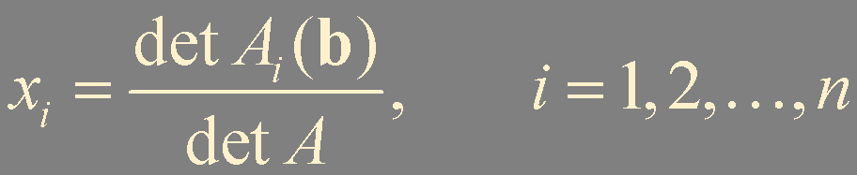
Cramer’s Rule
ith column
Theorem 7. Cramer’s Rule
Let A be an invertible n × n matrix. For any b in ℝ^{n}, the unique solution x of Ax = b has entries given by

Slide 3

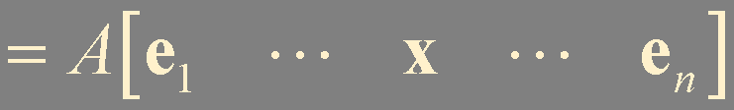
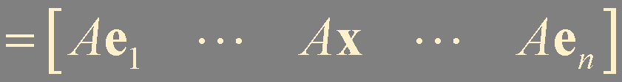
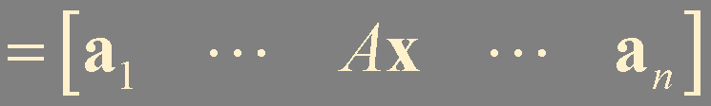


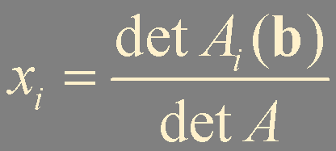

Slide 4
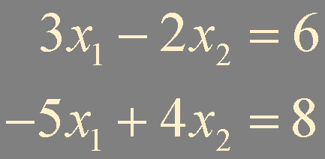
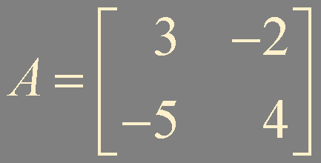
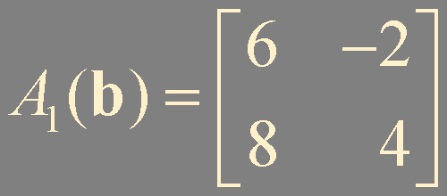
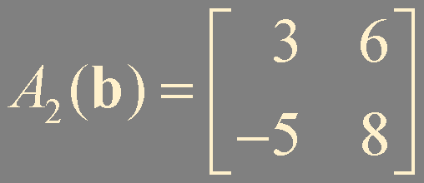
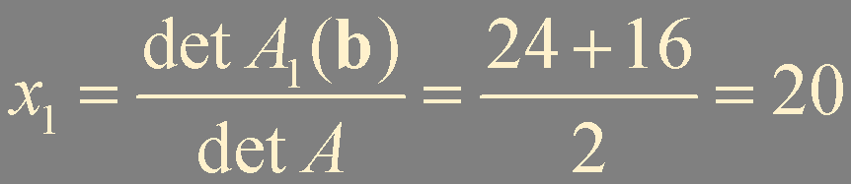
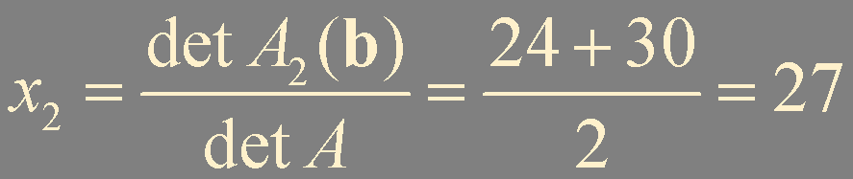
Example 1.

Slide 5
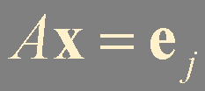
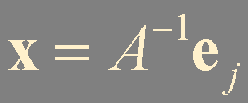
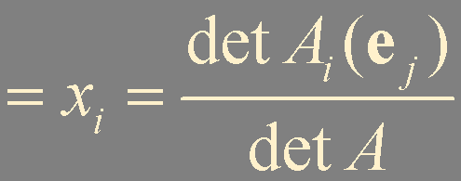
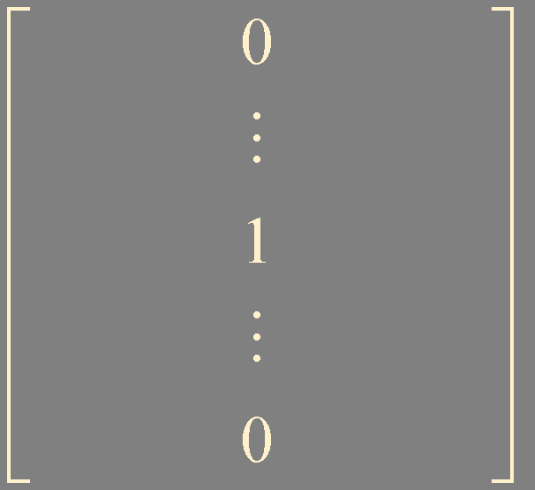

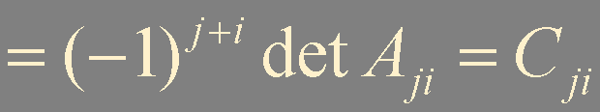
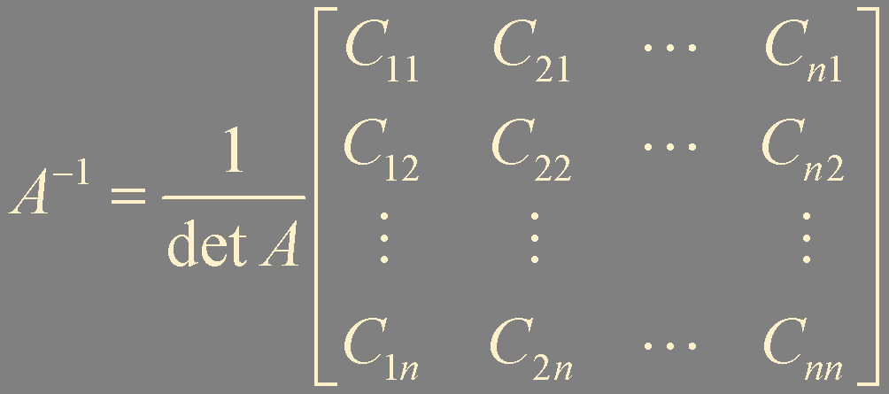
A Formula for A⁻¹
(i-j) entry of A⁻¹
jth row
ith column
adjugate of A (adj A)
classical adjoint of A

Slide 6
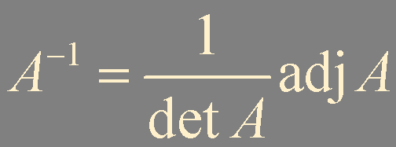
Theorem 8. An Inverse Formula
Let A be an invertible n × n matrix. Then

Slide 7
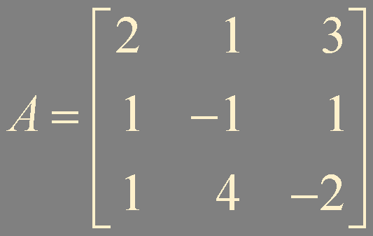
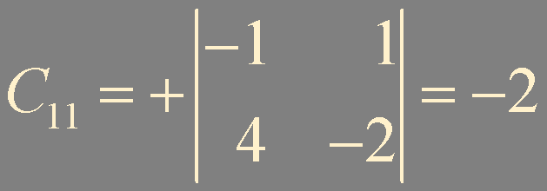
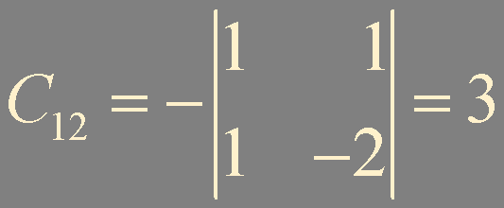
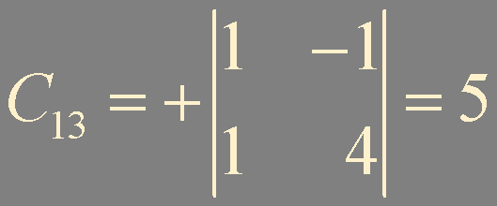
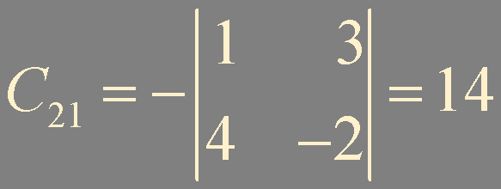
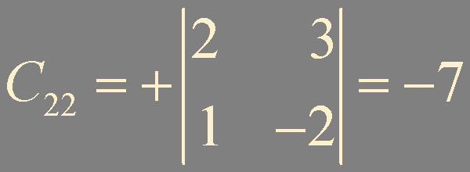
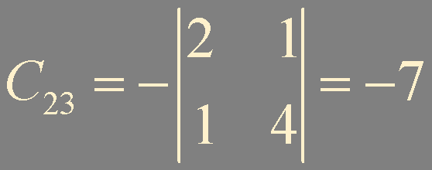
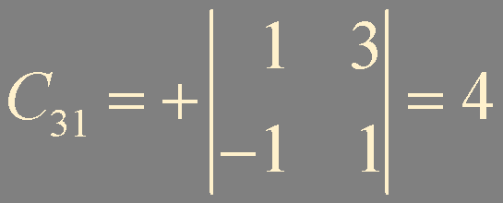
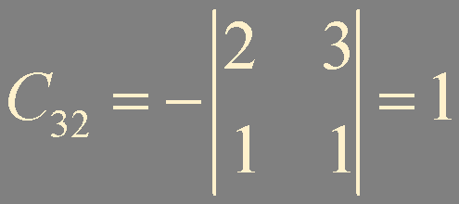
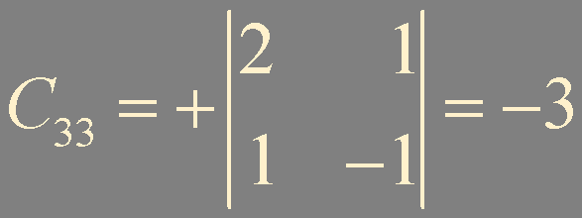
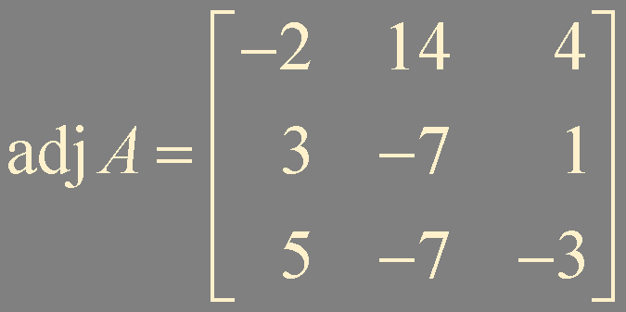
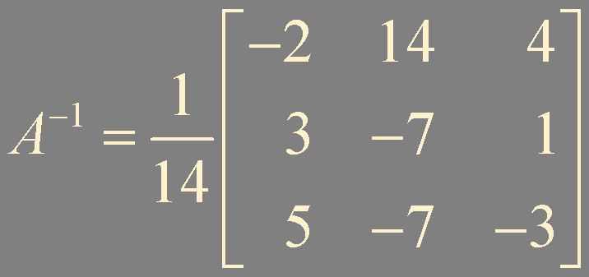
Example 2.

Slide 8

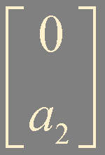

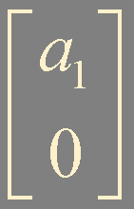

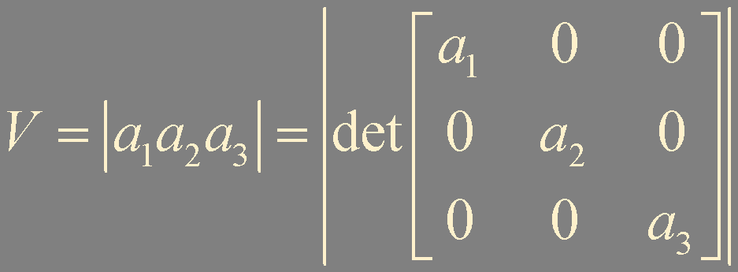
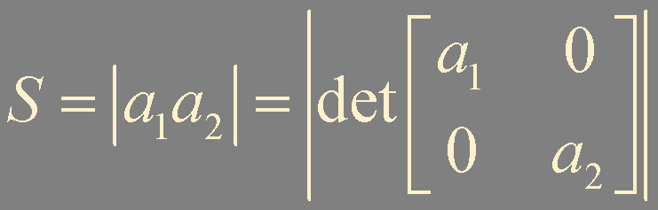
Determinants as Area or Volume
x₃
x₂
x₂
x₁
x₁

Slide 9
Theorem 9.
If A is a 2 × 2 matrix, the area of the parallelogram determined by the columns of A is |det A|
the volume of the parallelepiped determined by the columns of A is |det A|

Slide 10

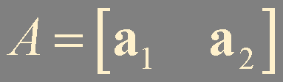
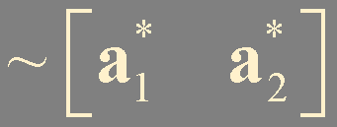
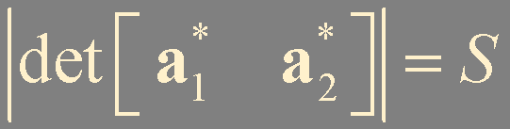
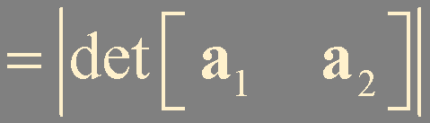

x₂
x₂
x₂
a₂
S
S
S
a₁
x₁
x₁
x₁
x₂
S
x₁

Slide 11
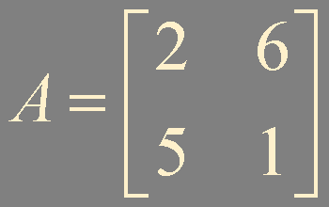
Example 3. Calculate the area of the following parallelogram
x₂
(2, 5)
(6, 1)
x₁
|2-30| = 28

Slide 12
Linear Transformation
Theorem 10.
Let T : ℝ² → ℝ² be a linear transformation determined by a 2 × 2 matrix A. If S is a parallelogram in ℝ², then
{area of T(S)} = |det A|⋅{area of S}
If T is determined by a 3 × 3 matrix A, and if V is a parallelepiped in ℝ³, then
{volume of T(V)} = |det A|⋅{volume of V}

Slide 13
x₂
x₂
b₂
Ab₂
T
S
T(S)
b₁
x₁
Ab₁
x₁
T(s₁b₁+s₂b₂) = s₁T(b₁) + s₂T(b₂)
= s₁Ab₁ + s₂Ab₂
[Ab₁ Ab₂]
= AB
{area of T(S)} = |det AB| = |det A| ⋅{area of S}

Slide 14
Generalization of Theorem 10
T
Theorem 10 holds whenever S is a region in ℝ² with finite area or a region in ℝ³ with finite volume

Slide 15
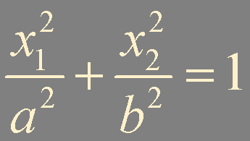


Example 4.
x₂
x₂
b
x₁
x₁
a

Slide 16
Summary
Cramer’s rule
Inverse formula
Determinants as area and volume
Linear transformation

